Slide 1




Covax Sentiment
Ayman Madhour, Lukas Bach

Slide 2

Agenda
MOTIVATION
DATA MINING
NATURAL LANGUAGE PROCESSING
SENTIMENT ANALYSIS
DATA ENGINEERING
VISUALIZATION
ABSCHLUSS

Slide 3

Motivation
Impfthematik in Deutschland
Mediale Behandlung von Impfstoffen und Nebenwirkungen
Meinung der Bürger?
Aufzeigen von regional abhängigen Unterschieden

Slide 4

DATA Mining
Dataset: IEEE Covid-19 Tweets
Tweet ID
Sentiment Score
Mining nach Tweet ID durch Twitter Bot (Hydration)
ID
User
Region
Impfstoff im Tweet erwähnt?
Notes:
This dataset includes CSV files that contain IDs and sentiment scores of the tweets related to the COVID-19 pandemic. The real-time Twitter feed is monitored for coronavirus-related tweets using 90+ different keywords and hashtags that are commonly used while referencing the pandemic. The oldest tweets in this dataset date back to October 01, 2019. This dataset has been wholly re-designed on March 20, 2020, to comply with the content redistribution policy set by Twitter. Twitter's policy restricts the sharing of Twitter data other than IDs; therefore, only the tweet IDs are released through this dataset. You need to hydrate the tweet IDs in order to get complete data.

Slide 5

Natural Language Processing
Twitter Daten werden vorbereinigt
Nicht relevante Tweets aussortieren
Beleidigungen löschen
-> Erhalten saubere Daten
Notes:
This dataset includes CSV files that contain IDs and sentiment scores of the tweets related to the COVID-19 pandemic. The real-time Twitter feed is monitored for coronavirus-related tweets using 90+ different keywords and hashtags that are commonly used while referencing the pandemic. The oldest tweets in this dataset date back to October 01, 2019. This dataset has been wholly re-designed on March 20, 2020, to comply with the content redistribution policy set by Twitter. Twitter's policy restricts the sharing of Twitter data other than IDs; therefore, only the tweet IDs are released through this dataset. You need to hydrate the tweet IDs in order to get complete data.

Slide 6

Sentiment Analyse
Twitter Daten werden vorbereinigt
Nicht relevante Tweets aussortieren
Beleidigungen löschen
Grammatikalische Fehler korrigieren
-> Erhalten saubere Daten
Notes:
This dataset includes CSV files that contain IDs and sentiment scores of the tweets related to the COVID-19 pandemic. The real-time Twitter feed is monitored for coronavirus-related tweets using 90+ different keywords and hashtags that are commonly used while referencing the pandemic. The oldest tweets in this dataset date back to October 01, 2019. This dataset has been wholly re-designed on March 20, 2020, to comply with the content redistribution policy set by Twitter. Twitter's policy restricts the sharing of Twitter data other than IDs; therefore, only the tweet IDs are released through this dataset. You need to hydrate the tweet IDs in order to get complete data.

Slide 7

Data Engineering
Twitter Daten werden vorbereinigt
Nicht relevante Tweets aussortieren
Beleidigungen löschen
Grammatikalische Fehler korrigieren
-> Erhalten saubere Daten
Notes:
This dataset includes CSV files that contain IDs and sentiment scores of the tweets related to the COVID-19 pandemic. The real-time Twitter feed is monitored for coronavirus-related tweets using 90+ different keywords and hashtags that are commonly used while referencing the pandemic. The oldest tweets in this dataset date back to October 01, 2019. This dataset has been wholly re-designed on March 20, 2020, to comply with the content redistribution policy set by Twitter. Twitter's policy restricts the sharing of Twitter data other than IDs; therefore, only the tweet IDs are released through this dataset. You need to hydrate the tweet IDs in order to get complete data.

Slide 8
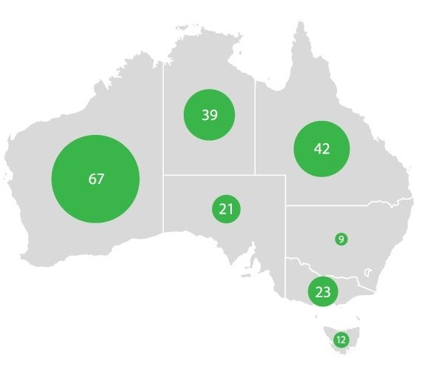
Visualisierung
Twitter Daten werden vorbereinigt
Nicht relevante Tweets aussortieren
Beleidigungen löschen
Grammatikalische Fehler korrigieren
-> Erhalten saubere Daten
Notes:
This dataset includes CSV files that contain IDs and sentiment scores of the tweets related to the COVID-19 pandemic. The real-time Twitter feed is monitored for coronavirus-related tweets using 90+ different keywords and hashtags that are commonly used while referencing the pandemic. The oldest tweets in this dataset date back to October 01, 2019. This dataset has been wholly re-designed on March 20, 2020, to comply with the content redistribution policy set by Twitter. Twitter's policy restricts the sharing of Twitter data other than IDs; therefore, only the tweet IDs are released through this dataset. You need to hydrate the tweet IDs in order to get complete data.

Slide 9
Vielen Dank
Ayman Madhour, Lukas Bach

